Slide 1

Building & Managing Effective Nursing Teams
A practical guide for nurse leaders to create high-performing teams in healthcare settings
BY: HAZIM NAEEM WAHEEB

Slide 2
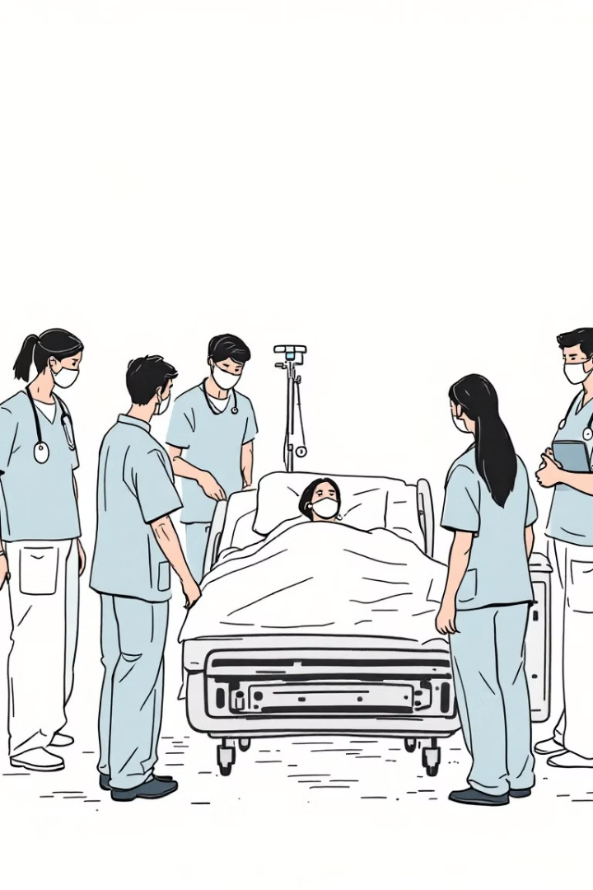
Why Team Building Matters in Nursing
1
Patient outcomes improve with cohesive teams
2
Reduces nurse burnout and turnover
3
Enhances communication during critical situations
4
Creates supportive environment for new nurses

Slide 3

Stages of Nursing Team Development
1
Forming
Team members are cautious, polite, establishing boundaries
2
Storming
Conflicts emerge as roles and processes are challenged
3
Norming
Team establishes workflows and builds trust
4
Performing
High efficiency, mutual support, shared leadership

Slide 4





Key Leadership Skills for Nurse Managers
Clear Communication
Collaborative Decision-Making
Constructive Feedback
Daily huddles and transparent information sharing
Regular, specific, balanced feedback sessions
Involve team in unit policies and workflows
Conflict Resolution
Address issues promptly and fairly

Slide 5





Building Trust in Nursing Teams
Transparency
Consistency
2
Share information openly
1
Be reliable in words and actions
Accountability
3
Take responsibility for outcomes
5
Support
Be present during challenges
4
Recognition
Acknowledge contributions fairly

Slide 6




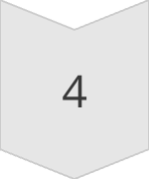
Effective Team Communication Strategies
Structured Handoffs
SBAR method for critical information transfer
Team Huddles
Brief daily meetings to address patient needs
Closed-Loop Communication
Confirm understanding of instructions
Constructive Feedback
Focus on behavior not person

Slide 7

Managing Team Conflicts
Identify Early Signs
Watch for changing behaviors, increased tensions
Address Privately First
Have one-on-one conversations before escalating
Focus on Issues Not People
Discuss behaviors and situations, not personalities
Document Agreements
Ensure clarity on resolutions and follow-ups

Slide 8




Team Recognition & Motivation
Personalized Appreciation
1
Tailored to individual preferences
Public Recognition
2
Celebrating team wins visibly
Growth Opportunities
3
Training and development paths
Basic Respect & Support
4
Day-to-day consideration of needs

Slide 9
Measuring Team Performance
Patient Outcomes
Team Dynamics
Efficiency Metrics
Infection rates, falls, medication errors
Turnover rates, staff satisfaction surveys
Response times, throughput, documentation compliance

Slide 10
Action Plan: Building Your Nursing Team
Assess Current Team Dynamics
Identify strengths and areas for improvement
Establish Clear Team Goals
Align with unit and organizational objectives
Implement Communication Structure
Regular huddles, feedback mechanisms
Develop Recognition System
Create formal and informal appreciation
Evaluate and Adjust
Regularly review team performance metrics

